Slide 1



Presented by :
UNIGE
Liam McLin & Dev Roy Chowdhury, and Co.
SmartSync
Adaptive Academic Calendar Secure, AI-enhanced calendar syncing UNIGE courses, exams & Moodle into one schedule

Slide 2


The problem
SmartSync
Having several calendars is complicated to manage.
Risk of missing deadlines due to an overload of syllabuses that are difficult and inconvenient to consult.
Lack of a centralised calendar complicates effective time planning
Notes:
SmartSync is a secure, AI-enhanced calendar that syncs UNIGE courses, exams, and Moodle data with students’ personal schedules.
Today, academic information is scattered across multiple platforms, forcing students to switch constantly and increasing the risk of missed deadlines and stress.
SmartSync unifies everything into one intelligent, integrated calendar—saving time and improving focus.

Slide 3



Methodology
SmartSync aggregates academic information from UNIGE sources into one pipeline.
It extract events (courses, exams, Moodle deadlines) and standardize them into a single format.
We merge events into a single unified calendar view.
An AI layer enriches events with labels, priority, and short summaries.
The final output syncs to a single calendar via iCal, compatible with Google and Apple Calendar

Slide 4


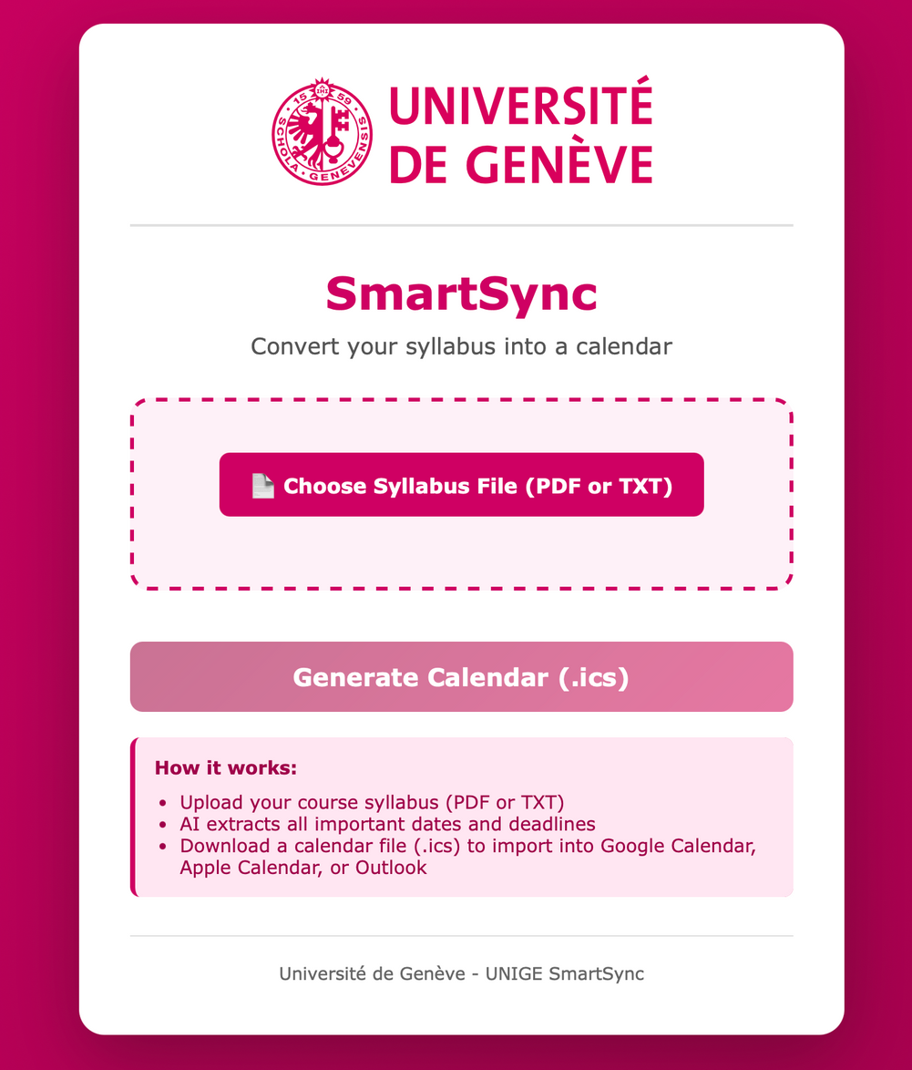

The solution
SmartSync

Slide 5


Slide 6



Short-Term Developments
Integrate the University Moodle API into the system ⟶ retrieve syllabus and exam data
Long Term Developments
Looking Into the Future
Enable the university to optimise exam dates based on aggregated availability through a background system
Work with the university to install in-house servers capable of running LLMs ⟶ privacy & security

